Slide 1
Qualitative and mixed methods
Class 10
EDUC 157: Educational Research and Evaluation
UCI School of Education

Slide 2
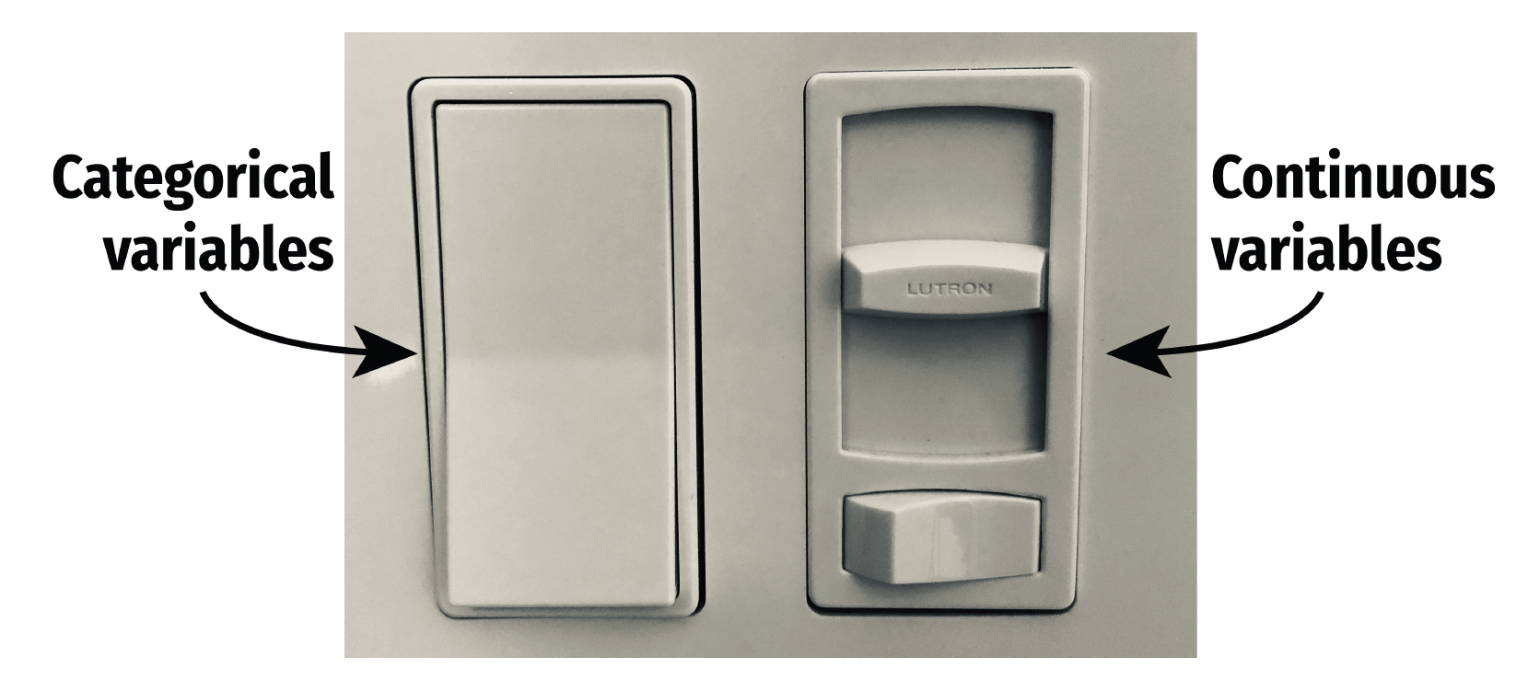

Slide 3
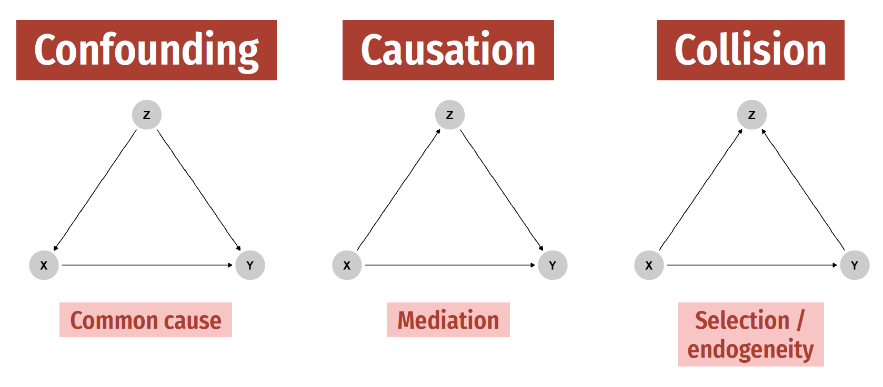

Slide 4
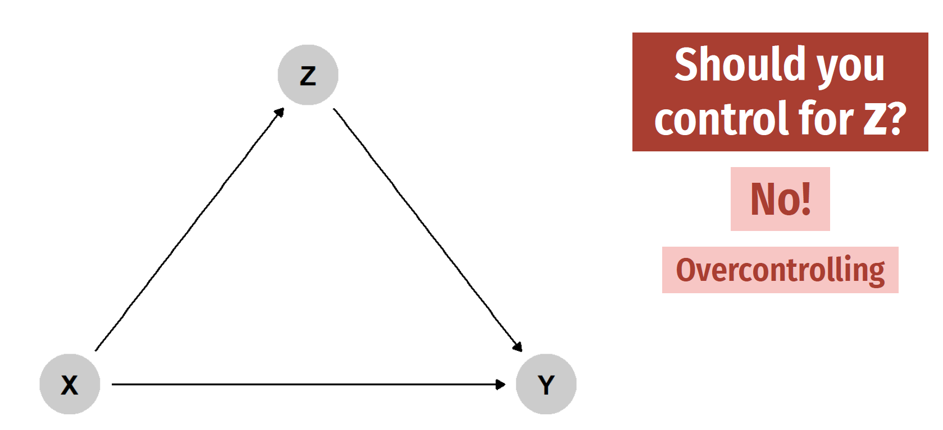

Slide 5


Slide 6
Plan for today
Qualitative research
Qualitative causal inference?
Leveraging qualitative research

Slide 7
Qualitative research

Slide 8
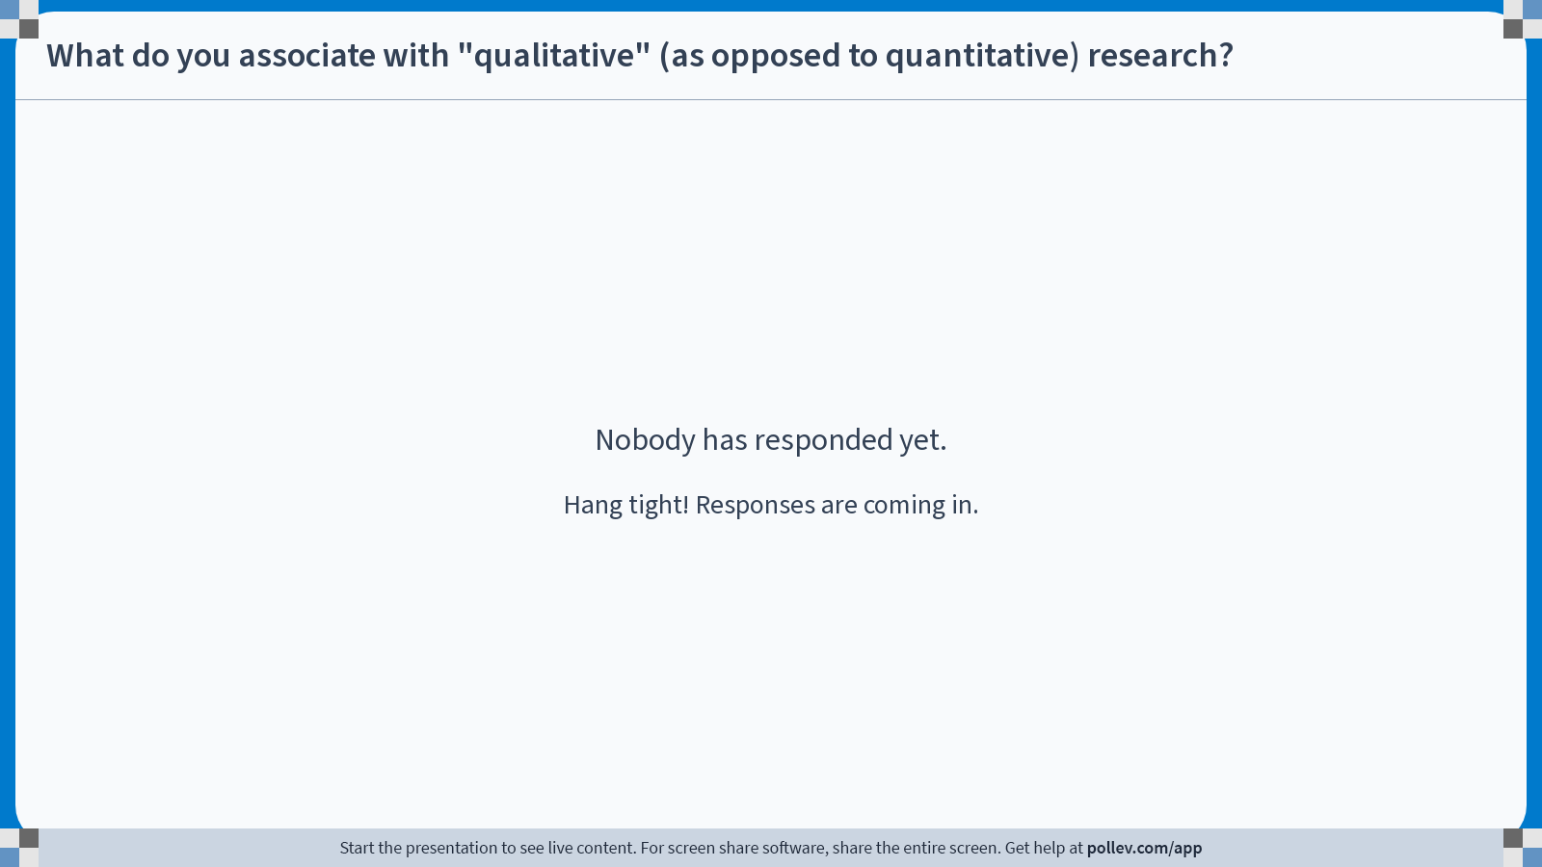
Notes:
Poll Title: Do not modify the notes in this section to avoid tampering with the Poll Everywhere activity. More info at polleverywhere.com/support What do you associate with "qualitative" (as opposed to quantitative) research? https://www.polleverywhere.com/free_text_polls/SMayhDwItp00xDVwxfPF8

Slide 9
Qualitative research
Sample
Data sources
Purpose
Epistemology
Small n
Focus groups
“Thick” description
Subjectivity
Can be unsystematic
In-depth interviews
Theory development
Flexibility
Case studies
Participant obs.
Induction
Nuance, complexity
Narrative analysis
“Giving voice”
Interpretivism
Content analysis
Action research
Constructivism
Combination thereof
Program development
Researcher positionality

Slide 10
Qualitative causal inference?

Slide 11
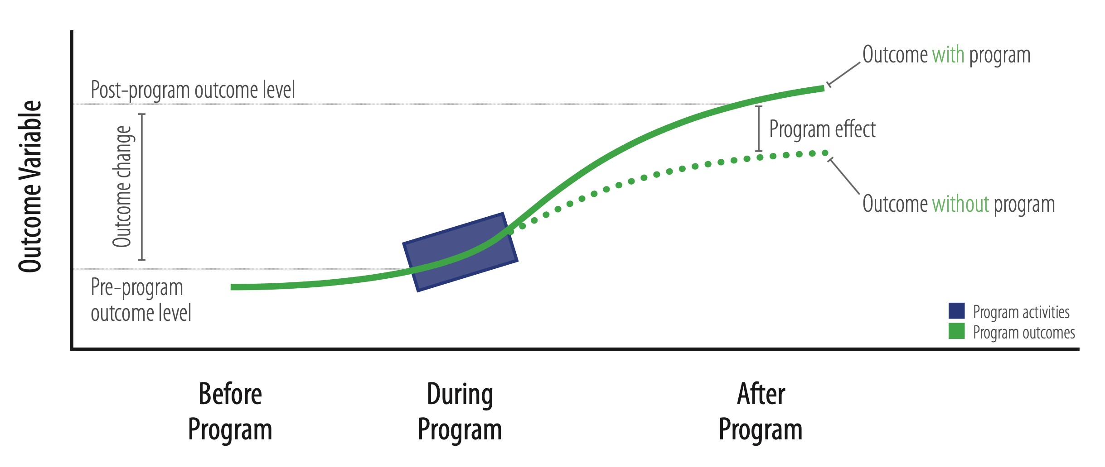

Slide 12
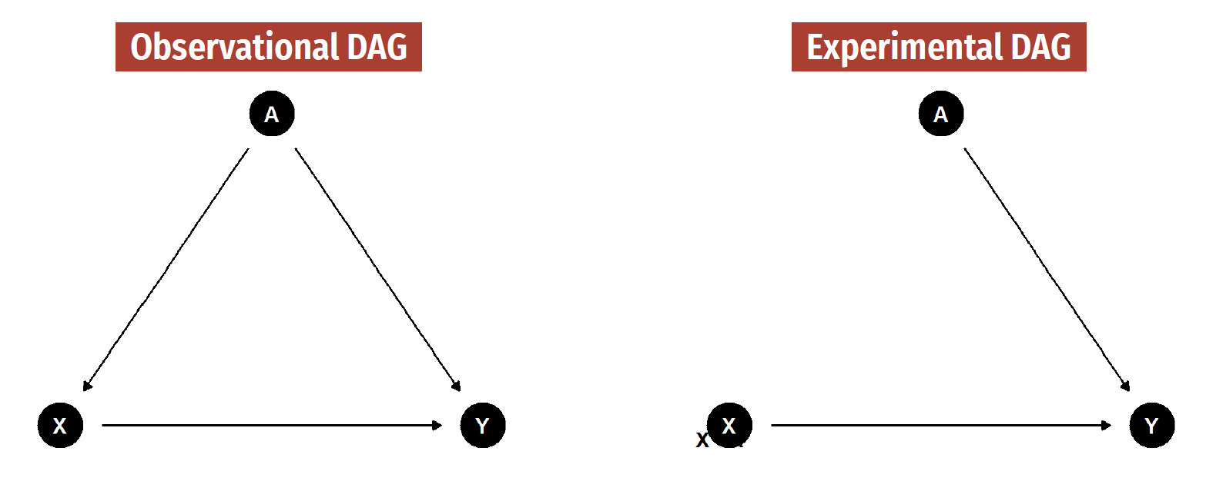

Slide 13
“Counterfactual reasoning”

Slide 14
“Just ask”

Slide 15
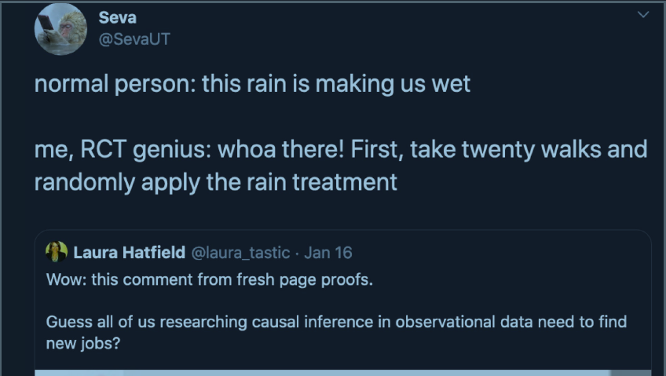
“Just watch”

Slide 16


The Californian “Case”: Multicollinearity

Slide 17

No variance on the dependent variable

Slide 18
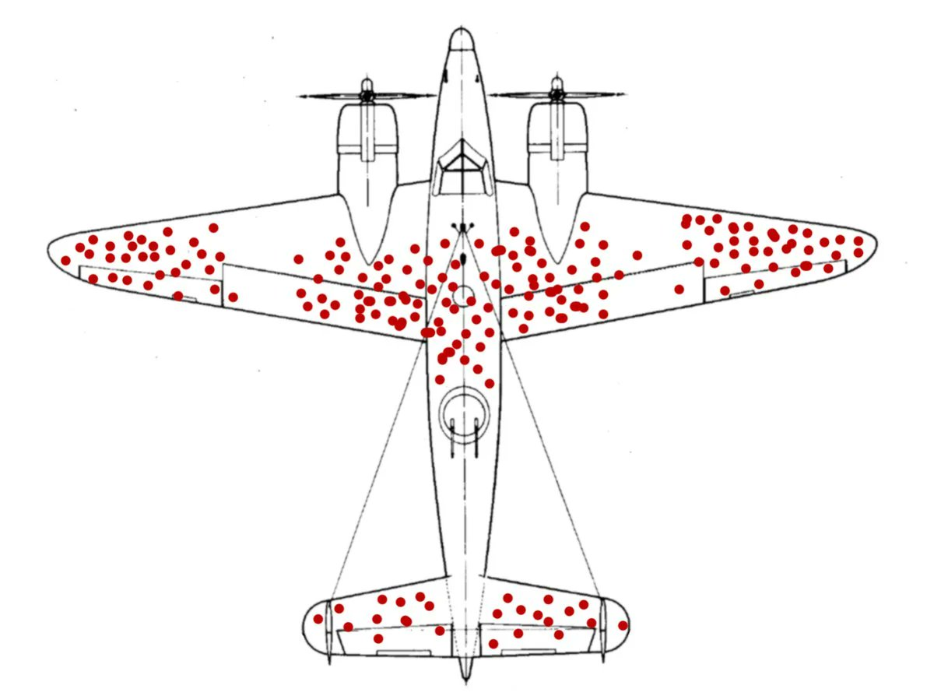
Survivor bias

Slide 19

Survivor bias and no variance

Slide 20


More inferences than observations

Slide 21
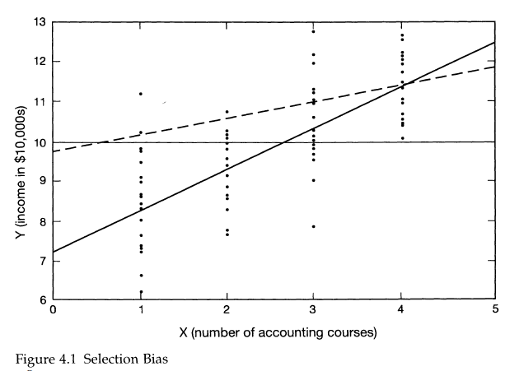
Selection on the dependent variable

Slide 22
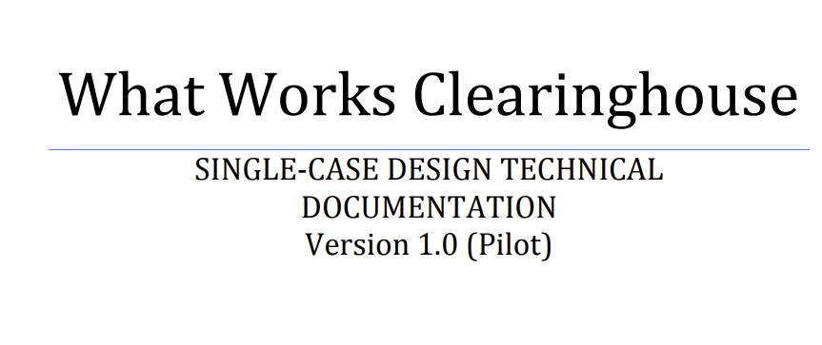
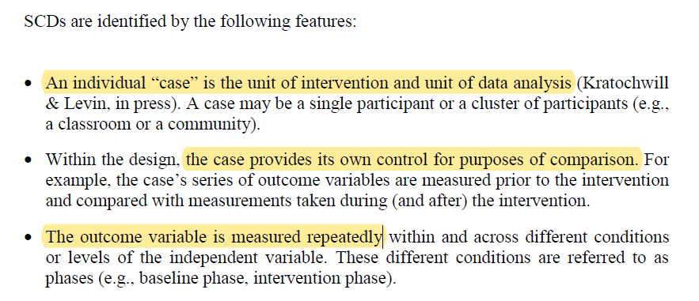
Single-case designs

Slide 23

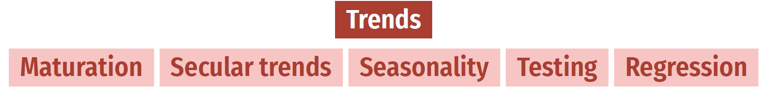
Single-case designs

Slide 24
Leveraging qualitative research

Slide 25
Opportunities to mix methods
Before
During
After
Theory development
Instrument development
Dissemination
Program development
Process tracing
Debating generalizability
Informing study design
Text, video as data
Understanding context
“Giving voice”

Slide 26



Case study
My work with Teaching at the Right Level (TaRL) Africa in Zambia combines in-depth interviews with a large-scale randomized trial across 182 zones.
Puzzle: TaRL is largely ineffective when implemented at scale.
Assumption: “We should design a new coaching intervention to improve uptake.”
Mixed-methods study: What drives teachers to change their instruction?
78 in-depth interviews
Combination of qualitative thematic analysis and unsupervised machine learning
Three main drivers point to the importance of school-based continuous professional development.
Pivot and program development: “How can TaRL support teachers through continuous professional development (CPD) in communities of practice?”
Multi-arm randomized trial: "Does continuous professional development improve Teaching at the Right Level in Zambia?"

Slide 27
“In the year before the COVID-19 crisis: Do you think you
changed the way you went about
your day-to-day teaching in the classroom? If so, how?”

Slide 28
Thematic analysis
Data preparation
Familiarization
Generating codes
Searching for themes
Defining themes
Coding
Writing narrative
Ensuring trustworthy-ness
Academic report

Slide 29
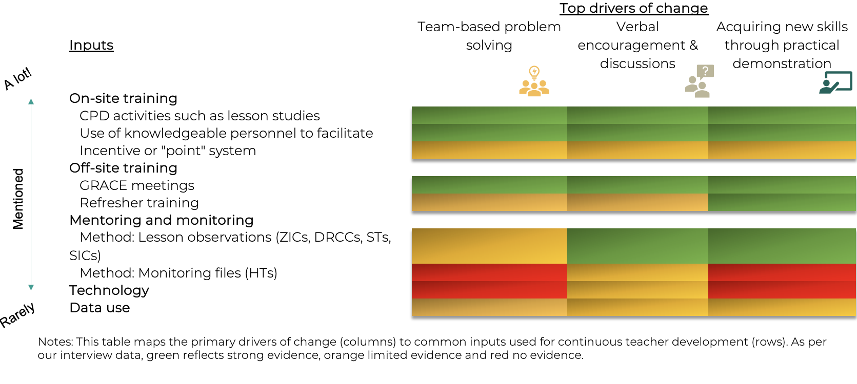
What we found out

Slide 30
Case study
My work with Teaching at the Right Level (TaRL) Africa in Zambia combines in-depth interviews with a large-scale randomized trial across 182 zones.
Puzzle: TaRL is largely ineffective when implemented at scale.
Assumption: “We should design a new coaching intervention to improve uptake.”
Mixed-methods study: What drives teachers to change their instruction?
78 in-depth interviews
Combination of qualitative thematic analysis and unsupervised machine learning
Three main drivers point to the importance of school-based continuous professional development.
Pivot and program development: “How can TaRL support teachers through continuous professional development (CPD) in communities of practice?”
Multi-arm randomized trial: "Does continuous professional development improve Teaching at the Right Level in Zambia?"

Slide 31
Announcements, plan for next class
Reading reactions
Submit on Canvas, ask for help on Slack
Exam: Study guide posted on course website
Student hours on Wednesday
Questions about DAMs?
Submit survey 2

